Slide 1
CS 110 - Professional Practices in IT Instructor Name : Dr Tariq Umer Email : tariqumer@cuilahore.edu.pk

Slide 2
Lecture -2 Privacy Risks and Principles

Slide 3
Topics Covered in this Lecture
Privacy key issues
Role of identity thefts
Key Data Thefts

Slide 4
Learning outcomes of this Lecture
To understand the Key Privacy issues
Role of Identity theft in Privacy.
To know different types of Identity threats under new era.

Slide 5
Key Privacy Issues
The rest of this lecture discusses a number of current and important privacy issues, including:
Identity theft
Customer profiling
Need to treat customer data responsibly
Workplace monitoring
Spamming
Advanced surveillance techniques

Slide 6
Identity Theft
Theft of key pieces of personal information to gain access to a person’s financial accounts
when someone steals key pieces of personal information to impersonate a person
Information includes:
Name
Address
Date of birth
Social Security number
Passport number
Driver’s license number
Mother’s maiden name

Slide 7
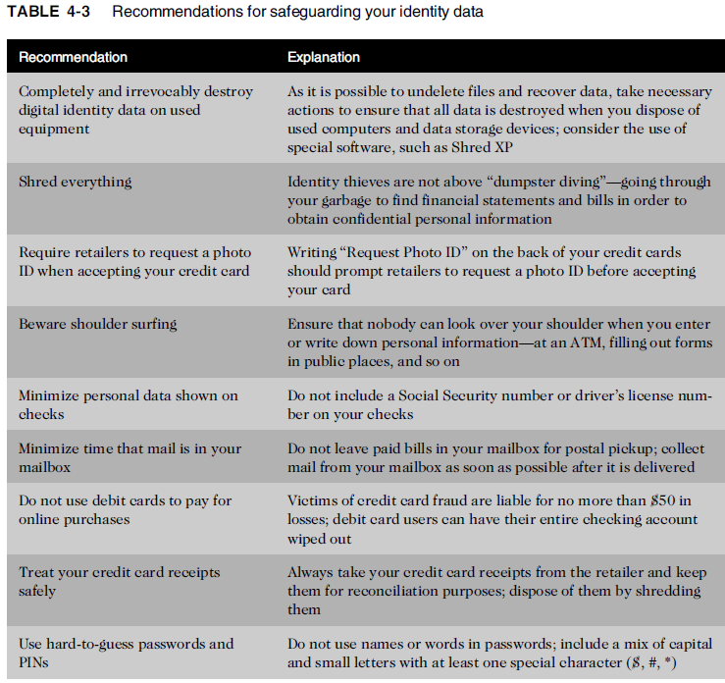

Slide 8
Identity Theft
Fastest growing form of fraud in the United States
Lack of initiative in informing people whose data was stolen
Using this information, an identity thief may apply for new credit or financial accounts, rent an apartment, set up utility or phone service, and register for college courses—all in someone else’s name.

Slide 9
Identity theft
Four approaches are frequently used by identity thieves to capture the personal data of their victims:
Create a data breach to steal hundreds, thousands, or even millions of personal records.
Purchase personal data from criminals.
Use phishing to entice users to willingly give up personal data.
Install spyware capable of capturing the keystrokes of victims

Slide 10
1: Data Breech
An alarming number of identity theft incidents involve breaches of large databases to gain personal identity information.
The breach may be caused by hackers breaking into the database or, more often than one would suspect, by carelessness or failure to follow proper security procedures.

Slide 11
2: Purchase of Personal Data
There is a black market in personal data.
Credit card numbers can be purchased in bulk quantity for as little as $.40 each, while the logon name and PIN necessary to access a bank account can be had for just $10.36
A full set of identity information including: date of birth, address, Social Security number, and telephone number—sells for between $1 and $15.37

Slide 12
3: Phishing
Attempt to steal personal identity data
By tricking users into entering information on a counterfeit Web site
Spear-phishing - a variation in which employees are sent e-mails that look like they came from high-level executives within their organization

Slide 13
4: Spyware
Keystroke-logging software downloaded to users’ computers without the knowledge or consent of the user
Enables the capture of:
Account usernames
Passwords
Credit card numbers
Other sensitive information
Operates even if an infected computer is not connected to the Internet
Identity Theft and Assumption Deterrence Act of 1998 was passed to fight fraud

Slide 14
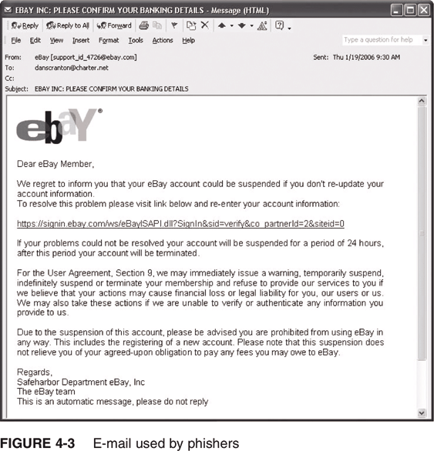
E-mail Used by Phishers

Slide 15
Consumer Profiling
Companies openly collect personal information about Internet users when they register at Web sites, complete surveys, fill out forms, or enter contests online
Cookies
Text files that a Web site puts on a user’s hard drive so that it can remember the information later
Tracking software: to allow their Web sites to analyze browsing habits and deduce personal interests and preferences
Similar methods are used outside the Web environment
Databases contain a huge amount of consumer behavioral data

Slide 16
Aggregating Consumer Data
Large-scale marketing organizations such as DoubleClick employ advertising networks to serve ads to thousands of Web sites. When someone clicks on an ad at a company’s Website, tracking information about the person is gathered and forwarded to DoubleClick, which stores it in a large database. This data includes a record of the ad on which the person clicked and what the person bought.
Affiliated Web sites
Group of Web sites served by a single advertising network
Customized service for each consumer

Slide 17
Collecting Data from Websites Visits
Marketers use cookies to recognize return visitors to their sites and to store useful information about them.
Types of data collected while surfing the Web
GET data
POST data
Click-stream data

Slide 18
Collecting Data from Websites Visits
Four ways to limit or even stop the deposit of cookies on hard drives
Set the browser to limit or stop cookies
Manually delete them from the hard drive
Download and install a cookie-management program
Use anonymous browsing programs that don’t accept cookies

Slide 19
Personalization software
Used by marketers to optimize the number, frequency, and mixture of their ad placements
Rules-based
Collaborative filtering
Demographic filtering
Contextual commerce
Platform for Privacy Preferences (P3P)
screening technology
Shields users from sites that don’t provide the level of privacy protection desired

Slide 20
Consumer Profiling (continued)
Rules-based personalization software uses business rules tied to customer-supplied preferences or online behavior to determine the most appropriate page views and product information to display when a user visits a Web site. Car rental adds on holiday booking websites etc.
Collaborative filtering offers consumer recommendations based on the types of products purchased by other people with similar buying habits. Same type of story writers etc

Slide 21
Consumer Profiling (continued)
Demographic filtering is another form of personalization software. It augments clickstream data and user-supplied data with demographic information associated with user zip codes to make product suggestions.
Contextual commerce, associates product promotions and other e-commerce offerings with specific content a user may receive in a news story online.

Slide 22
THE END

